Slide 1


Pixel Post
Our blogging backend combines Node.js, EJS, and Multer for robust content management.

Slide 2


Built with Node.js, Express, and EJS
Node.js
Express
A JavaScript runtime environment that allows us to build fast and scalable backend applications.
A popular web framework that provides a robust foundation for building our backend API.
EJS
A templating engine that allows us to create dynamic and engaging blog posts.

Slide 3

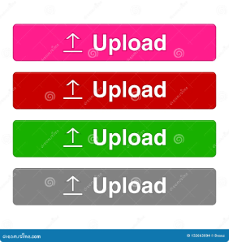


Multer for File Uploads
Seamless Uploads
File Security
Multer makes it easy for users to upload images and other files directly to their blog posts.
We prioritize security and have implemented robust measures to protect uploaded files from unauthorized access.

Slide 4


Validation Modules for Data Integrity
1
Data Accuracy
2
Error Prevention
We use validation modules to ensure that all data submitted by users is accurate and meets our quality standards.
Validation helps prevent errors and ensures that our database remains consistent and reliable.
3
User Experience
Validation helps us provide users with clear and helpful feedback, guiding them through the posting process.

Slide 5


Scalable and Efficient Platform
1
Scalability
Our platform is built to scale effortlessly, handling a large volume of users and content without compromising performance.
2
Performance Optimization
We've implemented various optimizations to ensure that our platform runs smoothly and delivers fast loading times.
3
Resource Management
We've designed our platform to efficiently manage resources, ensuring optimal performance even under high demand.

Slide 6

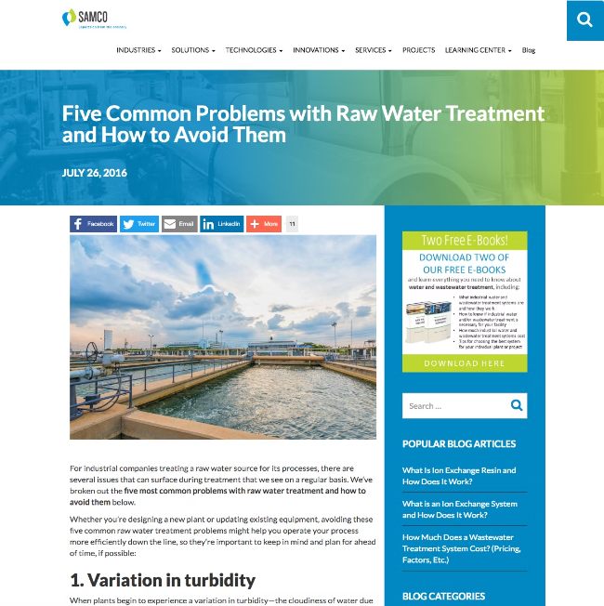



Dynamic, Media-Rich Blogging Experiences
Dynamic Content
Our backend supports dynamic content, allowing users to easily create and manage interactive blog posts with different media types.
Media Integration
Our platform seamlessly integrates images, videos, and other media formats, enhancing user engagement.
Content Management System
Our user-friendly content management system allows bloggers to easily create, edit, and publish content.

Slide 7

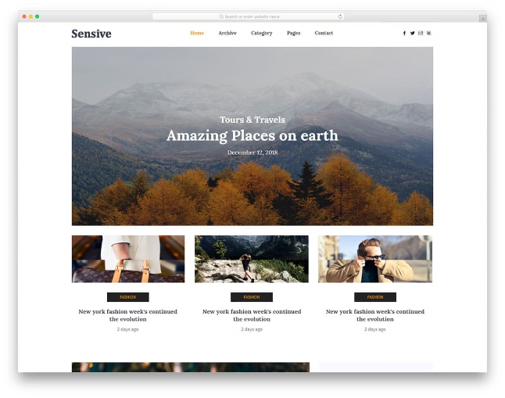
Powering Your Online Content
Easy-to-use interface
Allows users to create and manage content effortlessly.
Customizable themes
Provides bloggers with flexibility to personalize their blog's appearance.
SEO optimization
Helps bloggers reach a wider audience by improving their blog's visibility in search engines.
Community features
Encourages engagement with comments and social sharing.

